Slide 2
Visual Studio Lightswitch
TRACK: Next Gen
Robert MacLean
www.sadev.co.za
BBD Software

Slide 3
Agenda
Introduction to Lightswitch
New Toolset for Development
Forms over data
Build applications quickly, consistently using proven practices
“Russian Doll” model with Visual Studio
Beta 2
  Things may change
  My excuse for crashes too

Slide 4
demo
Lightswitch demo

Slide 5
Summary
Introduction to Lightswitch
Easy to build apps
Great architecture
  Silverlight on the front end
  WCF in the middle
  Correctly structured
  Security & deployment taken care of
Extensible!
  Custom fields, controls, themes & layouts

Slide 6
Calls to Action
Grab the bits and start to play & experiment
Join in the discussion on the Social Forums
Slides + Demos up Friday @ www.sadev.co.za

Slide 7
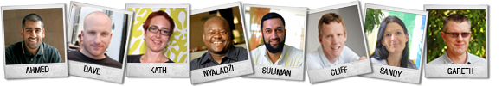



Keep in Touch
facebook.com/msdevsa
@msdevsa
http://blogs.msdn.com/southafrica

Slide 8

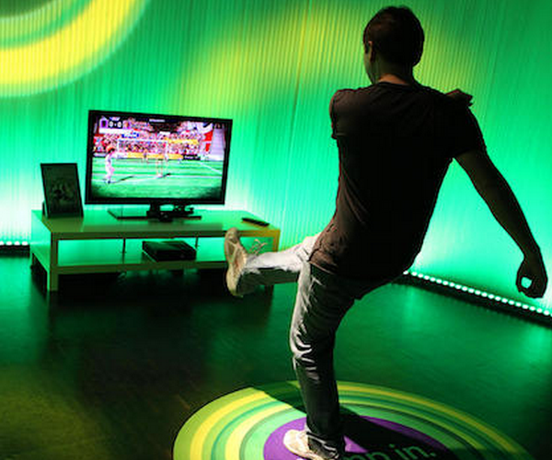
Don’t forget the Xbox Kinect show-down after sessions this evening!

Slide 9





DevDays 2011 Sponsors
PLATINUM SPONSOR
www.bbd.co.za
SILVER SPONSOR
www.dvt.co.za
SILVER SPONSOR
www.ctutraining.co.za

Slide 10
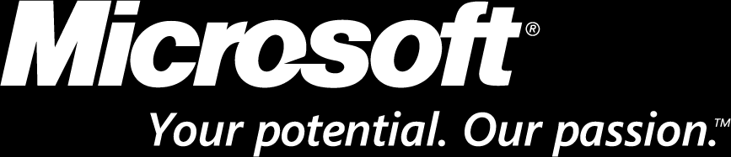
© 2008 Microsoft Corporation. All rights reserved. Microsoft, Windows, Windows Vista and other product names are or may be registered trademarks and/or trademarks in the U.S. and/or other countries.
The information herein is for informational purposes only and represents the current view of Microsoft Corporation as of the date of this presentation. Because Microsoft must respond to changing market conditions, it should not be interpreted to be a commitment on the part of Microsoft, and Microsoft cannot guarantee the accuracy of any information provided after the date of this presentation. MICROSOFT MAKES NO WARRANTIES, EXPRESS, IMPLIED OR STATUTORY, AS TO THE INFORMATION IN THIS PRESENTATION.

